Slide 1
Drug Prescription Dataset Analysis
Overview and Key Insights

Slide 2
Overview of the Dataset
This dataset contains information on patients including their age, sex, blood pressure (bp), cholesterol levels, and Na_to_K ratio (sodium to potassium). The goal is to understand which factors influence the prescription of a specific drug.

Slide 3
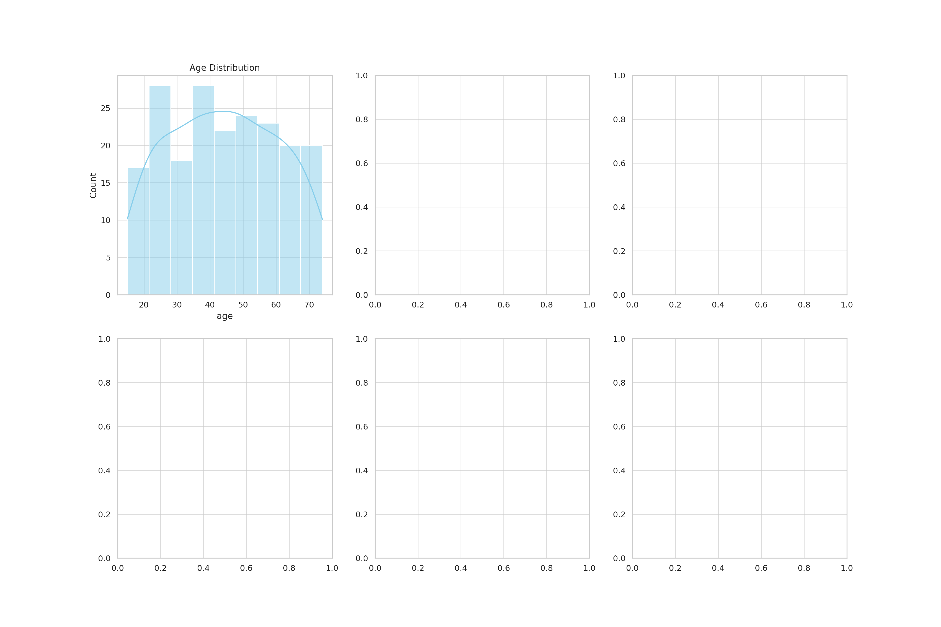
Visualization 1

Slide 4
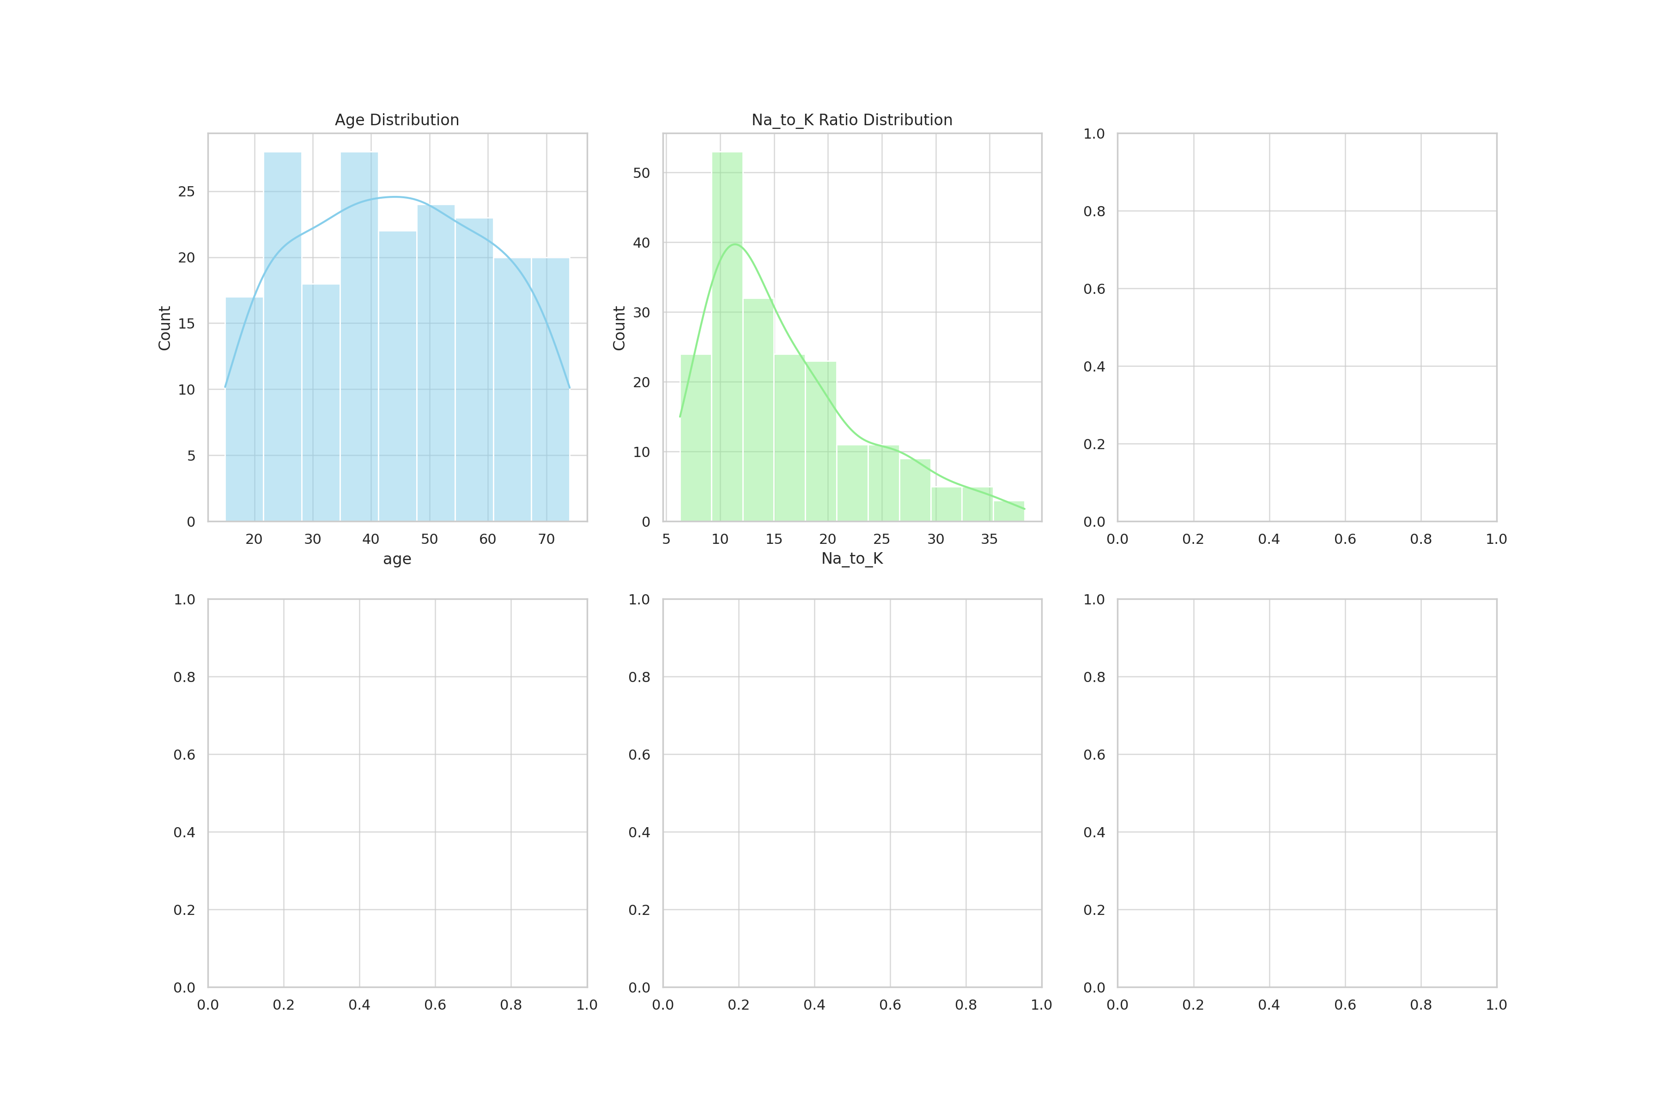
Visualization 2

Slide 5
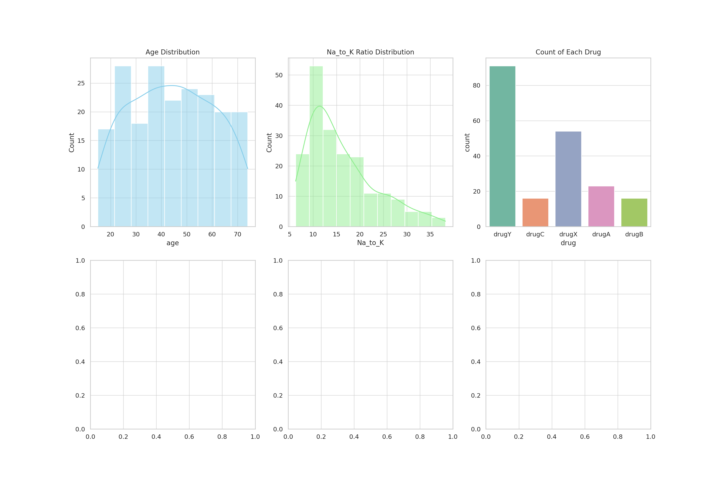
Visualization 3

Slide 6
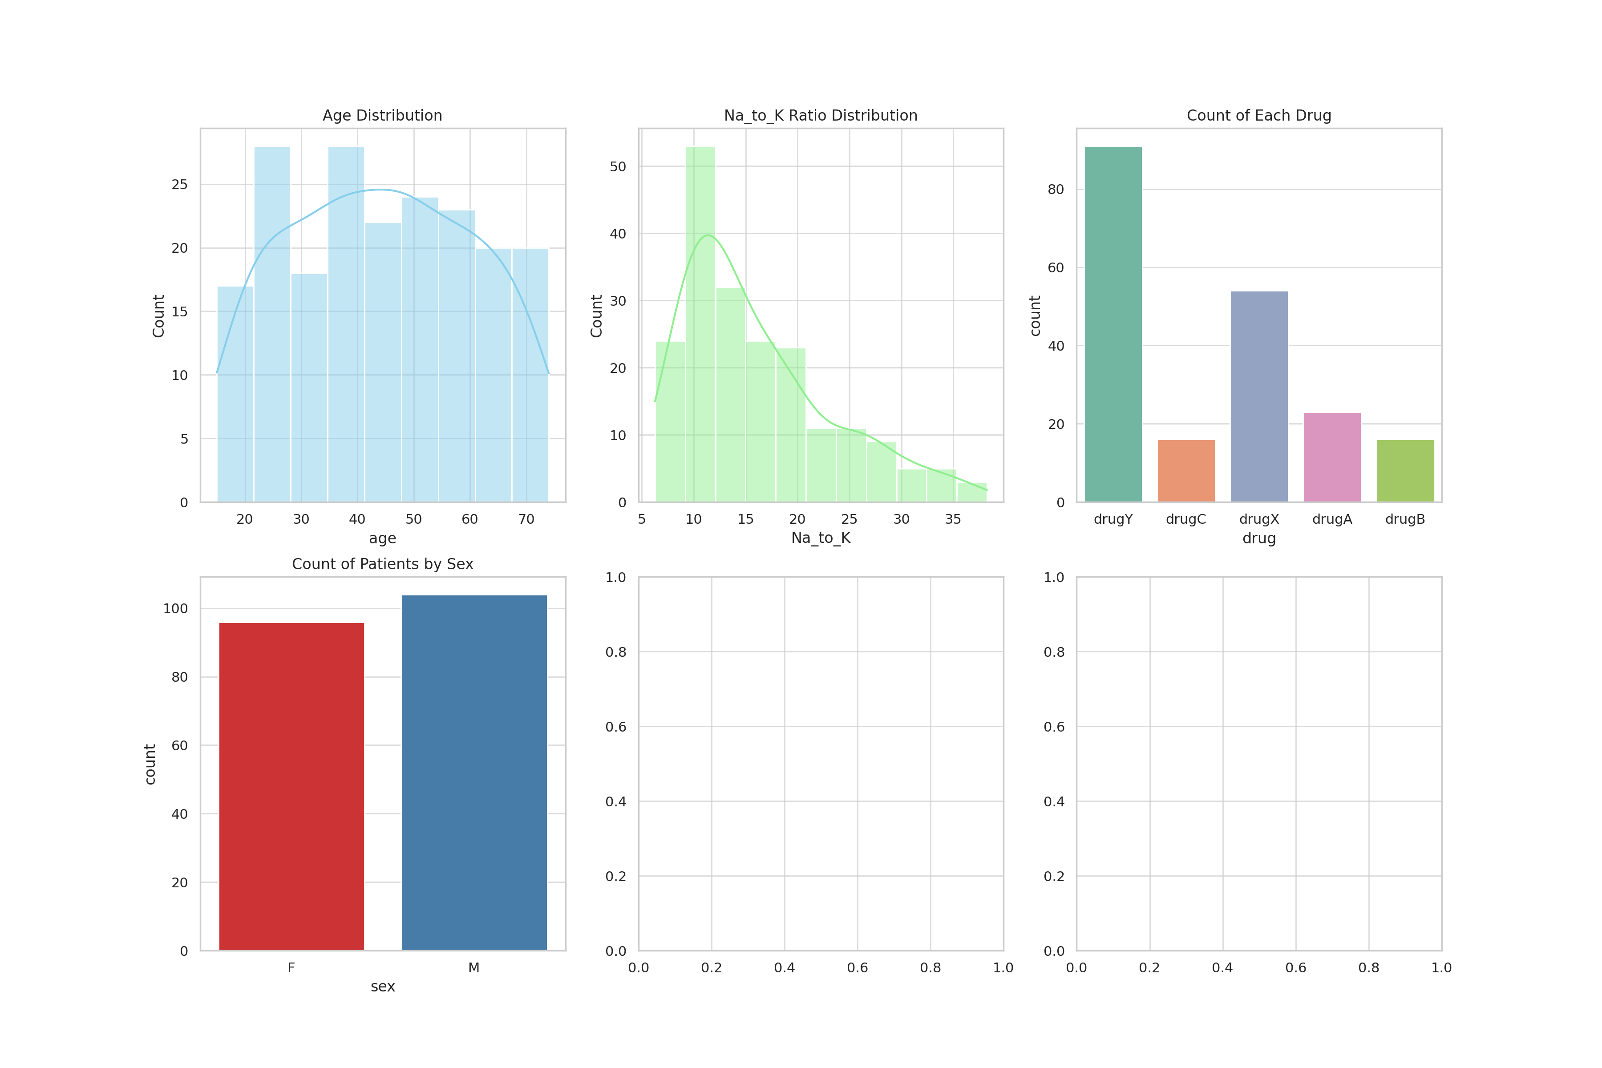
Visualization 4

Slide 7
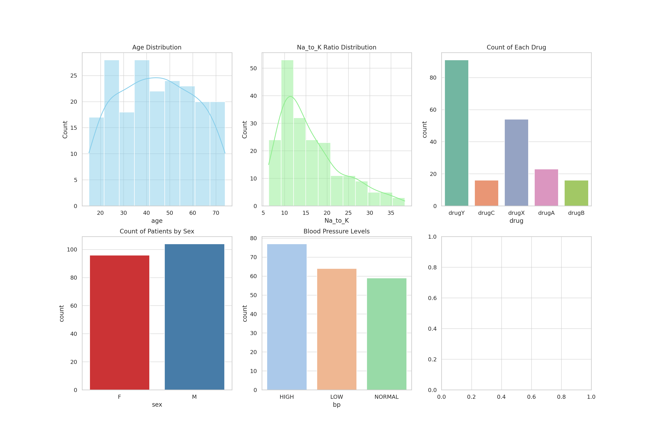
Visualization 5

Slide 8
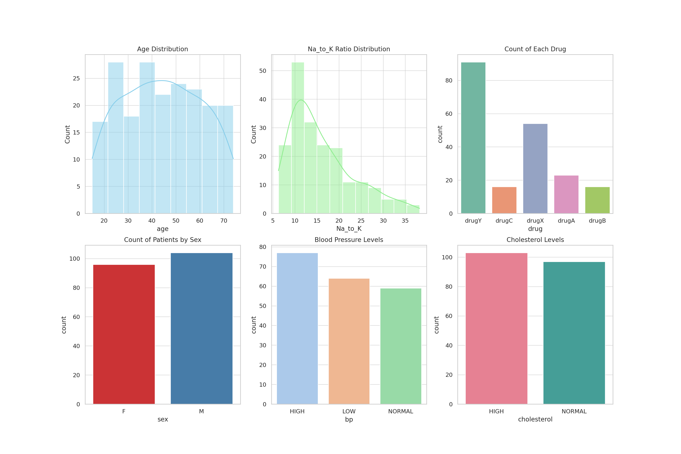
Visualization 6

